Slide 1
Ghostbusters (2016) Game Evaluation Report
May 15, 2019
Marjorie Ann Cuerdo
Frauline Agarin
HCI 590: Games User Research
DePaul College of Computing and Digital Media

Slide 2
Overview
(Click on links below to jump to respective sections)
Executive Summary
Competitive Review
Heuristic Review
Usability Test
Playtest

Slide 3
Main Research Objectives
Why was Ghostbusters (2016) received poorly by players?
How does the game compare to its competitors?
What usability issues do players encounter?
Is the game player experience enjoyable for players?

Slide 4
Executive Summary
Ghostbusters (2016) is a twin-stick action shooter video game. We examined the game on the Xbox One platform through four stages.
Competitive Review
Tier 1 competitors were other Ghostbusters-themed games.
Tier 2 were other movie-based third-person action shooters.
Tier 3 were other purely top-down isometric third-person action shooters.
We found that Ghostbusters (2016) was unique in being the only movie-based top-down isometric third-person action shooter, apart from Reservoir Dogs: Bloody Days (2017).
Heuristic Review
We used Sauli Laitinen’s game heuristics (2008) based on Jakob Nielsen’s heuristics. We found that most of the usability and gameplay heuristics were violated in the game, as the underlying critical issue was that the game’s main goals and objectives were unclear. Lack of appropriate feedback and help to the player can cause confusion as to how mechanics/controls relate to the scoring system.

Slide 5
Executive Summary
Usability Test
Although players felt confident due to the simplified gameplay, this test round confirmed the heuristic review findings that there would be usability issues. Players found objectives, controls/mechanics, and navigating the game user interface and maps to be confusing and detrimental.
Playtest
In assessing the game’s playability, we found that players enjoyed the game’s aesthetics and found AI teammates to be helpful. However, it’s critical that most players found the overall gameplay to be repetitive and not fun, leading them to say the levels were too long. Most players weren’t motivated to continue playing the game after the tutorial level. The major usability issues revealed in the last round were found to result in overall dissatisfaction with the player experience.
We have provided recommendations to specifically address these issues to improve on the foundation that Ghostbusters (2016) currently has for a better player experience.

Slide 6


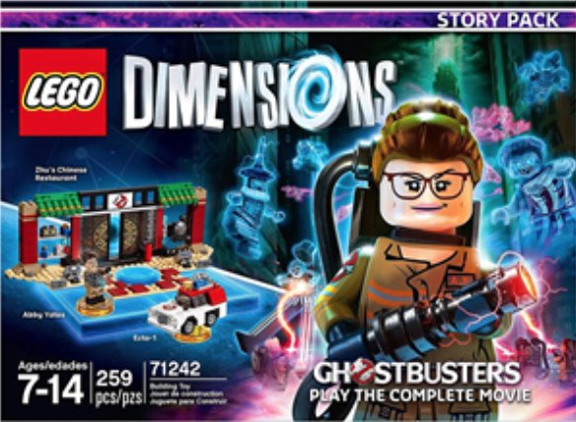
Competitive Review: Tier 1 Competitors Related Ghostbusters franchise games
Ghostbusters: Sanctum of Slime (2011)
Co-op twin stick shooter
Local and online co-op multiplayer modes
AI teammate options
No weapon upgrades
No cutscenes or voice narration
2. Ghostbusters: The Video Game (2009)
Third-person shooter (Nintendo DS is top-down)
Local and online multiplayer modes
Weapon upgrades available
3 difficulty levels: normal, experienced, professional
Uses same characters from Ghostbusters II
Lego Dimensions: Ghostbusters Story Pack (2016)
Action-adventure 3D platformer
2-player local co-op
Weapon and character upgrades available
Uses same characters from Ghostbusters (2016)

Slide 7


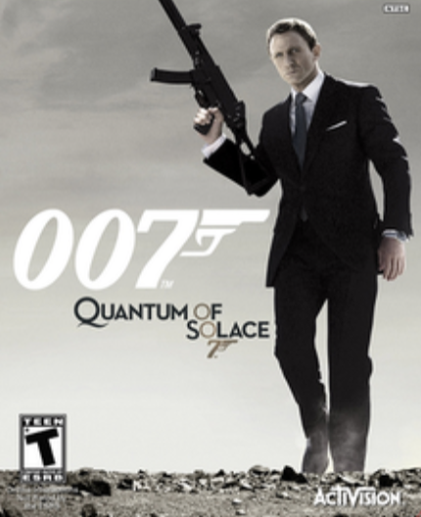
Competitive Review: Tier 2 Competitors Movie-based action shooter games
Reservoir Dogs: Bloody Days (2017)
Top-down isometric third person shooter
No multiplayer modes; 1 player for 3 characters
Defeat enemy waves for every level
No cutscenes or voice narration
2. Star Wars Battlefront II (2017)
Switch between third- and first-person
Campaign: solo; has other multiplayer modes
Has player upgrades
3 difficulty levels: explorer -> soldier -> special forces
Uses same characters from franchise and cutscenes
007: Quantum of Solace (2008)
First-person: PC, PS3, Xbox 360
Third-person: Nintendo DS and PS2
2-4 players in local and online co-op multiplayer (Wii)
Weapon and character upgrades available
Uses voice acting, dialogue, and events from movies

Slide 8
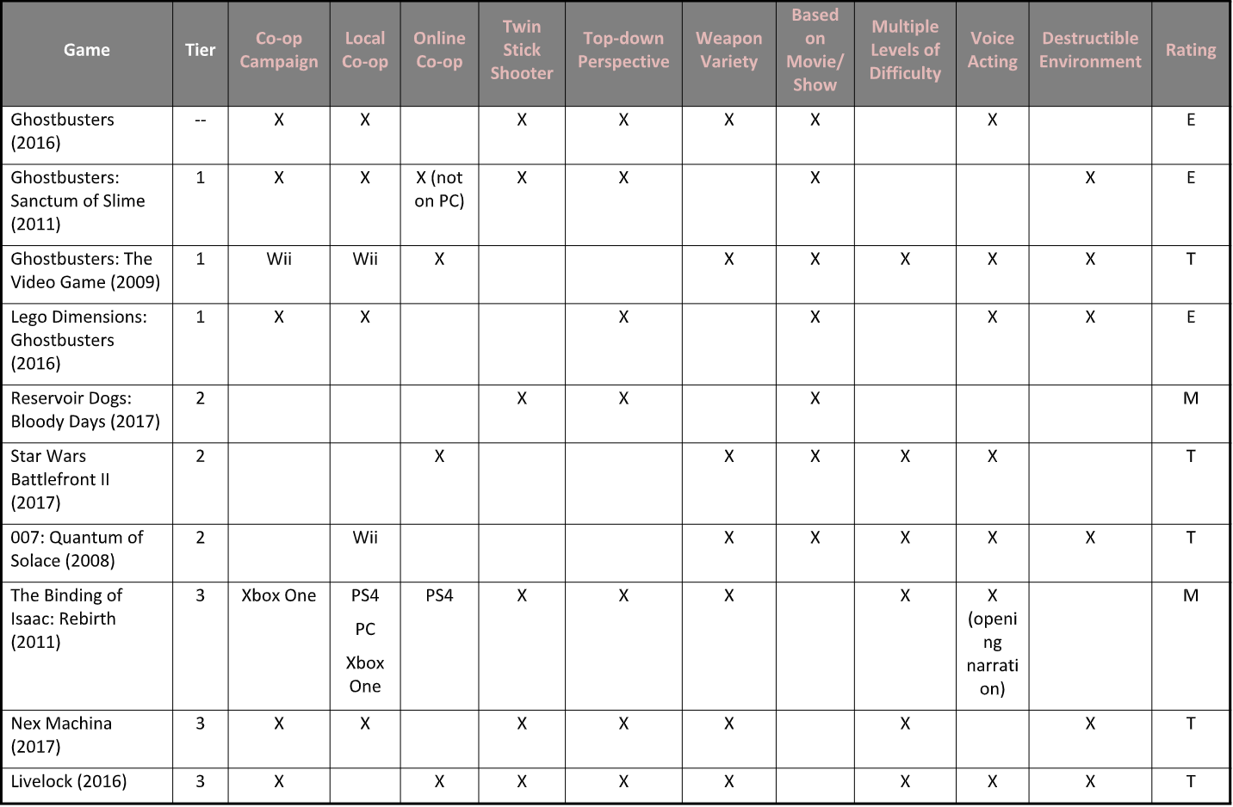
Competitive Review: Summary

Slide 9
Heuristic Review
We used Sauli Laitinen’s game heuristics (2008) based on Jakob Nielsen’s heuristics. These heuristics are split between usability and gameplay.
We found that most of the usability and gameplay heuristics were violated in the game:
Goals/objectives are unclear throughout the game
The relationship of mechanics to the scoring system is unclear
Lack of feedback and available help/assistance to player when they are confused
Tasks are repetitive and monotonous, throwing off the game’s challenge and pacing

Slide 10
Usability Test
Main Research Goals
Assess effectiveness of game UI
Identify issues interaction issues in the following game activities:
Complete the tutorial level (“Gertrude’s Revenge” in “Aldridge Manor Level”)
Upgrade character skills
Complete the post-tutorial level (“St. Lou’s Cemetery Level”)
Research Questions
Can players start new games?
Can players move their character?
Can players roll to dodge attacks?
Can players shoot/attack with their main weapon?
Can players throw bombs?
Can players cool off their overheated weapon?
Can players be revived by teammates?
Can players capture main ghosts/bosses?
Can players upgrade their character’s skills?
Can players navigate to required checkpoints in a level?
Can players find the next level?

Slide 11
Usability Test: Participants
Four participants who were in the range of 21-28 years old.
Participants were screened for:
They are at least 18 years old.
They have played on Xbox before (this was the available console for testing).
All participants had played shooter games before – 3 rating their skills average; 1 excellent.
3 out of 4 participants typically played games for 30-60 minute sessions; 1 for 60-90 minutes.
3 out of 4 participants rated their competitiveness as average; 1 rated theirs very high.
Commonly played games genres were RPGs and first-person shooters (FPS).

Slide 12
Usability Test: Prioritization
Positive issues indicate good practice, where the feature worked as intended.
Critical issues are those that occured on a core task, were not easy to overcome, and occured persistently for the same user. Fix urgently.
High issues met two of the criteria of occuring on a core task, being hard to overcome, or occuring persistently.
Medium issues either occurred on a core task, were hard to overcome, or occured persistently.
Low issues were usability issues that met none of the criteria, but too many of them will impact people’s perception of the experience.
Positive
Critical
High
Medium
Low

Slide 13
Highlights

Slide 14
Usability Test:
Positive
Participants did not think the game was unnecessarily complex.
(3 out of 4 participants)
In the post-test questionnaire, participants were asked to rate their agreement from 1-5 (1 = strongly disagree, 5 = strongly agree) with the statement: “I found the game unnecessarily complex.”
“It’s a pretty straightforward game…”

Slide 15
Usability Test:
Positive
Participants felt fairly confident playing the game.
In the post-test questionnaire, participants were asked to rate their agreement the statement: “I felt very confident playing the game.” The average score for this statement was 3.75.

Slide 16
Usability Test:
Positive
Participants found menu interfaces simple and easy to understand.
3 out of 4 participants were able to select the correct level and start the game without confusion.
“I thought that in general, the menu options were really sort of clear in what I’m doing.”

Slide 17
Lowlights

Slide 18
Usability Test:
Critical
Players don’t know the required objectives in the game.
All participants were frustrated and guessed what their tasks were (e.g. capture bosses, earn points, find secret runes, etc.).
All participants skipped audio that revealed the main ghost to capture.
Learnability problems tied to a high number of unique issues for tasks:
Intro tutorial level: 8.5 issues per player on average
Cemetery level (post-tutorial): 6.75 unique issues per player on average
“I don’t know what I’m supposed to be doing. There are no objectives, literally. Do I just explore the entire mansion?”
“Do I just walk around the cemetery again? I really wish I had objectives!”
“No objectives. No nothing. This is just boring. I don’t know what I’m supposed to be doing.”
“Do we even need to capture these ghosts?”
“Do I need to scan surroundings to make the ghosts appear?”
“What am I supposed to find here?”

Slide 19
Usability Test:
Critical
Players don’t know the required objectives in the game.
Include clear objectives in the game. Examples:
Reaching a certain number of points
Defeating specific enemies
The objectives should be easily accessible in a menu or subtly displayed on screen.

Slide 20
Usability Test:
High
Players don’t understand the points and achievement system.
The points and achievements system were not explained in the introductory tutorial level.
This led to participants not knowing what objects and parts of the game they should interact with.
“Are these points for us?”
“I don’t even know [about getting points]. I think it correlates to the upgrade points. I didn’t even know it mattered.”
“I’m assuming these points are what you use to upgrade but the fact is, it didn’t connect to me if I could get more points, I could really get more cooler upgrades. There was no incentive for me to press rapidly for the trap. There was no incentive for me to go search out these things. I don’t even know what the 2 out of 4 thing is. It’s like okay, I found it I guess, by accident. It’s not like I specifically went out and looked for it.”

Slide 21
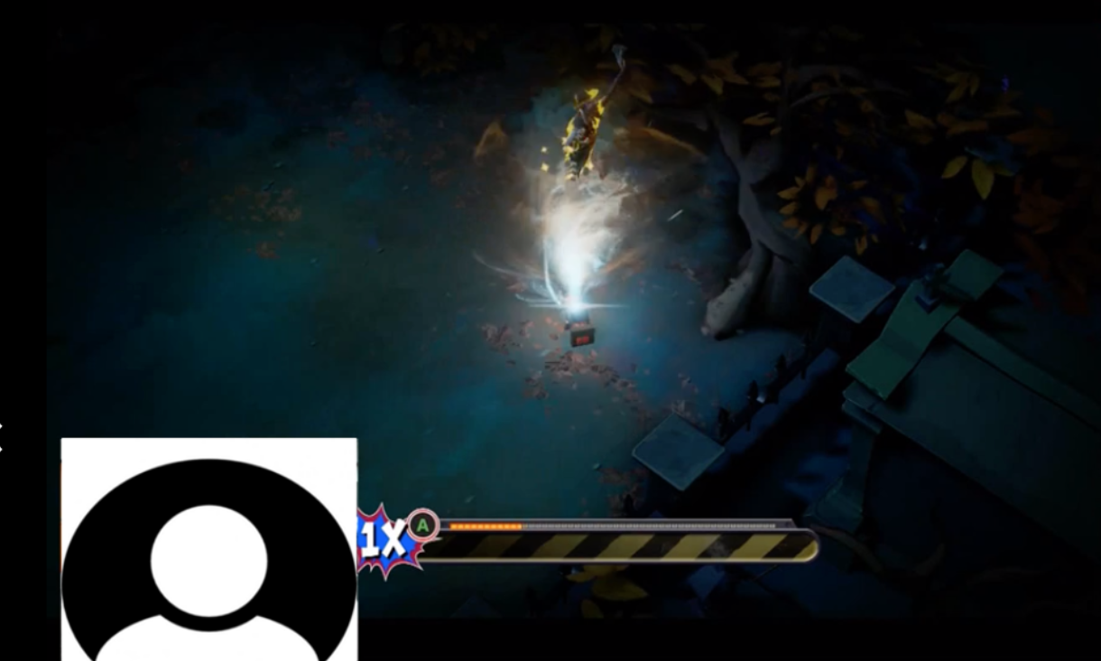
Usability Test:
High
Players don’t understand the points and achievement system.
In the tutorial, include explanations and descriptions of the points and achievements system.
Introduce what objects and parts of the game players can interact with.
Provide clear visual and audio feedback when objects are interacted with.
Participant 2 ignores the bonus points multiplier mini-game closer to the end of the gameplay session.

Slide 22
Usability Test:
High
Players had trouble keeping track of the multiple indicators for a character’s health and weapon status with the layout on the screen.
“It’s hard to keep track of overheating because I’m looking at where my bullets are going and not my character. There should be a crosshair…”
(After realizing the circle that is under character is a grenade cooldown indicator) “I didn’t know that! It would be nice if they’d let me know.”
“It’s really hard to tell who’s firing what and who’s who when we’re all bunched up together. They just look too the same. It’d be nice if they each had a different color palette… I keep instinctively looking at everyone else.”
“I really would’ve liked if all of the health was on the same side so it’s easier to keep track of them. Kinda like how in traditional games, if you have a party system, everybody will be on the left.”
“I wish the bomb cooldown indicator was more obvious at the corner of the screen. I’m not gonna be checking the corner for my stats with everything going on on-screen. It’s out of my peripheral vision.”

Slide 23
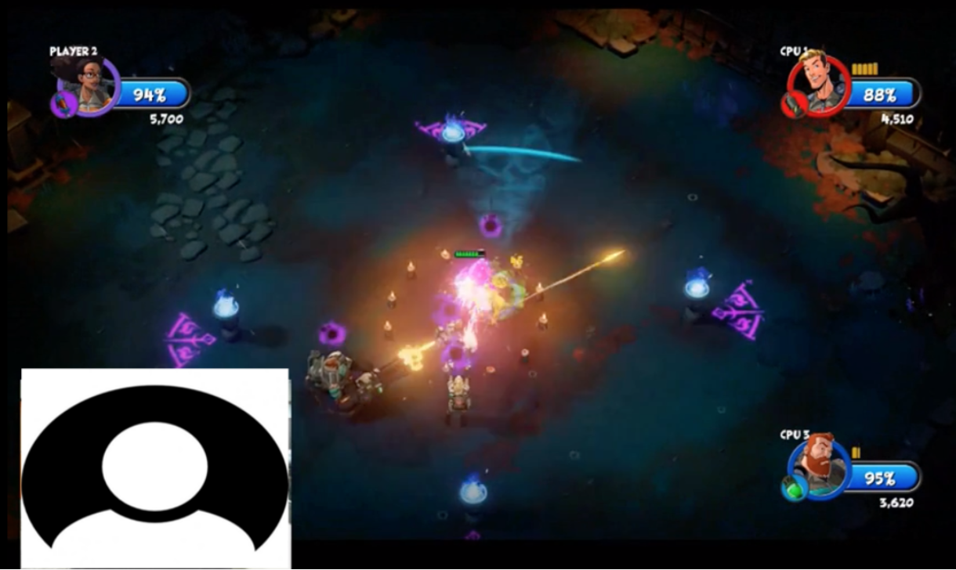
Usability Test:
High
Players don’t understand the points and achievement system.
In the tutorial, introduce the cool-down mechanics for weapons and grenades.
Status bars could be distinguished by a glowing effect, increase in size, and or location change.
Consider moving all health bars to one side.
Consider differentiating each character’s appearance more distinctly.
Consider changing health bar to red (as blue is confused for magic/mana).
Participant 2 ignores the bonus points multiplier mini-game closer to the end of the gameplay session.

Slide 24
Playtest

